Slide 1
Data Science Engineering Methods and Tools Lecture 4
Northeastern University
College of Engineering
Multidisciplinary Graduate Engineering Department
INFO 6105 – Fall 2025
Instructor: Abdolreza Mosaddegh

Slide 2
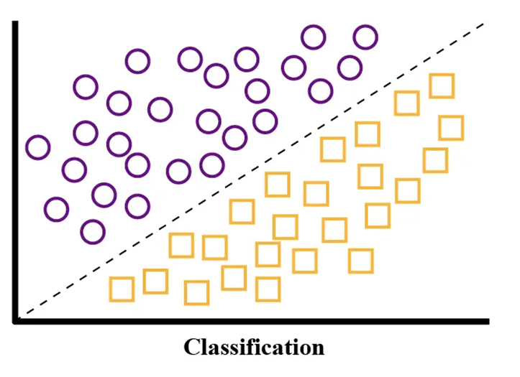
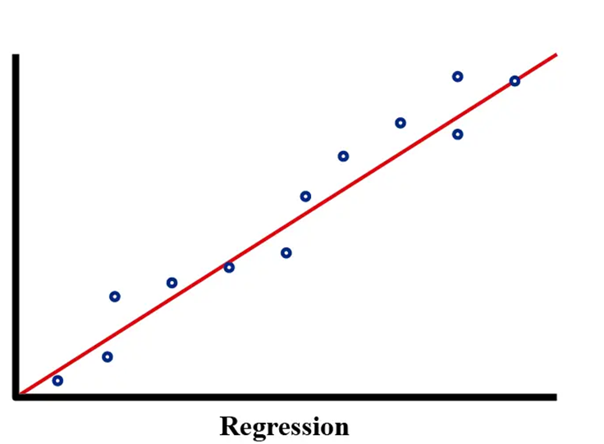
Types of Supervised Learning
There are two categories of supervised methods:
1- Classification: The output of the model is a class label
Goal: To assign one of a finite set of predefined classes to an input
Example: Predicting sepsis vs normal based on fever, etc.
2- Regression: The output of the model is a continuous value
Goal: To assign a numerical value to an input
Example: Predicting house prices based on living area , etc.

Slide 3
Regression Analysis
Regression analysis is a statistical method which is used to:
Predict the value of a response variable based on the value of at least one explanatory variable
Explain the impact of changes in an explanatory variable on the response variable
Since regression falls under supervised learning category, the algorithm is trained with both input features and output variable.
Murder-rate= 2.56 poverty −29.91

Slide 4
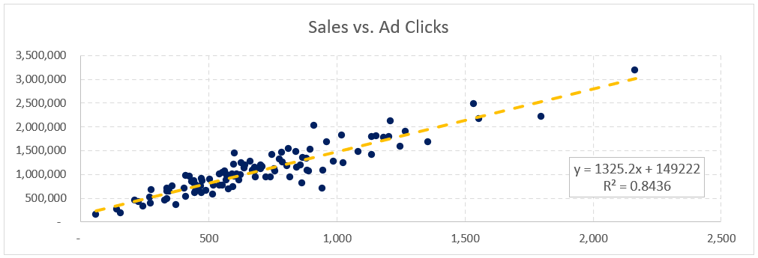
Applications of Regression
Regression is one of the most widely used statistical and machine learning methods:
Business & Finance: e.g., Stock price/ economic Indicators/ revenue forecasting/ sales and demand predict
Healthcare: e.g., Predicting disease progression / risk assessment
Social Sciences: e.g., Forecasting social and economical changes.
Time-series Analysis: e.g., regressing a variable against time units

Slide 5
Regression Equation
Represents the relationship between a dependent variable (outcome of the model) and one or more independent variables (features) may contribute to predicting that outcome.
Main Questions for Regression:
Predictors: which variables can significantly explain the dependent variable?
Relationship: What is the nature of relationship between independent variables and the dependent variable?
Model Type: what type of regression model can model this relationship best?
Dependent
Variable
Independent
Variables
Salary = a*Working-Hours + b*Work-Experience + c*Education-Level + … + 50000

Slide 6
Linear Regression
Fitting the data: Finding the best straight line (regression line) that represents the relationship between the independent variables and the dependent variable
Regression Equation is a mathematical representation of the regression line.
Income = b * College-Degree + a

Slide 7
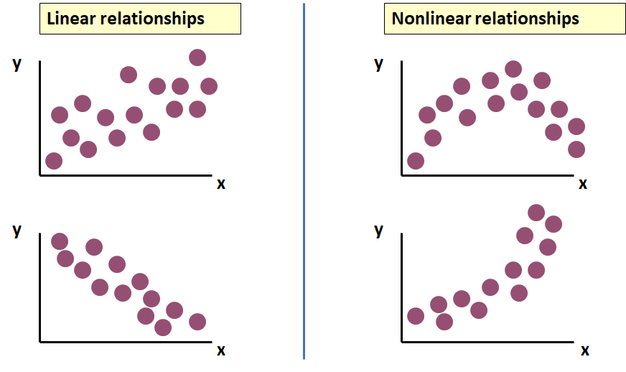
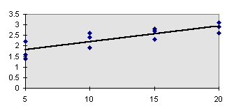
Relationship Type
Which type of relationships can be modeled by linear regression?
In Linear Regression, relationship between x and y is described by a straight line (y = bx + a).
Only linear relationships can be modeled using Linear Regression Model
Linear Regression

Slide 8
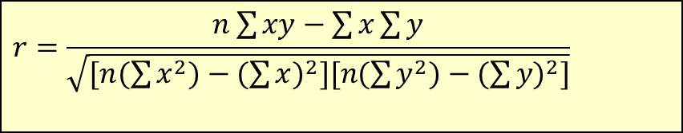
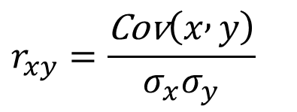
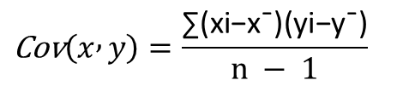
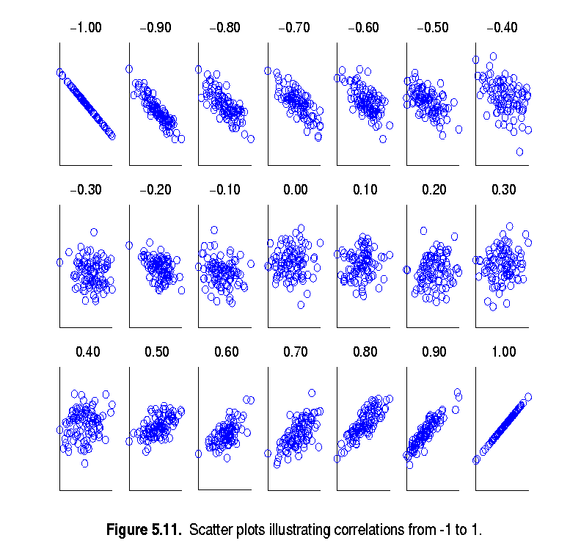
Linear Relationship - Correlation Coefficient
Covariance: Shows x and y are moving in the same direction (positive) or opposite direction (negative) or unrelated linearly (0):
SD: Measures the spread of each variable
Pearson Correlation coefficient (r): measures the linear relationship between two variables using Cov and SDs, ranges between −1 and +1
$$\text{Cov}\left(x , y\right)=\frac{\text{∑}\text{(}\text{xi}\text{​}\text{−}\text{x}\text{ˉ)(}\text{yi}\text{​}\text{−}\text{y}\text{ˉ​)}}{n − 1}$$
$$r_{xy}=\frac{\text{Cov}\left(x , y\right)}{σ_{x}σ_{y}}$$
$$r=\frac{n\sum{xy−\sum{x\sum{y}}}}{\sqrt{[n(\sum{x^{2})−(\sum{x)^{2}][n(\sum{y^{2})−(\sum{y)^{2}]}}}}}}$$

Slide 9
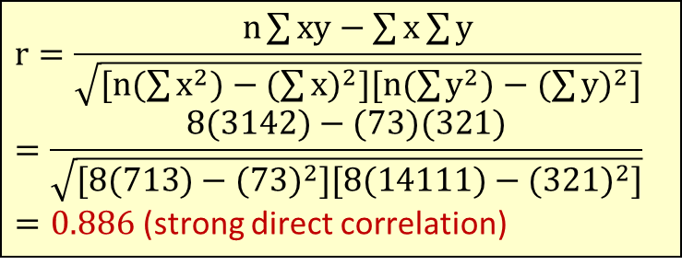
Correlation Coefficient - Example
Is there a linear correlation between height of a tree and diameter of trunk based on the following data?
Tree Height
(y)
Tree Height | Trunk Diameter
y | x | xy | y² | x²
35 | 8 | 280 | 1225 | 64
49 | 9 | 441 | 2401 | 81
27 | 7 | 189 | 729 | 49
33 | 6 | 198 | 1089 | 36
60 | 13 | 780 | 3600 | 169
21 | 7 | 147 | 441 | 49
45 | 11 | 495 | 2025 | 121
51 | 12 | 612 | 2601 | 144
Σ=321 | Σ=73 | Σ=3142 | Σ=14111 | Σ=713
Trunk Diameter (x)
$$r=\frac{n\sum{\text{xy}−\sum{x\sum{y}}}}{\sqrt{[n(\sum{x^{2})−(\sum{x)^{2}][n(\sum{y^{2})−(\sum{y)^{2}]}}}}}} \\ =\frac{8(\text{3142})−(\text{73})(\text{321})}{\sqrt{[8(\text{713})−(\text{73})^{2}][8(\text{14111})−(\text{321})^{2}]}}$$ $=\text{0.886}$ (strong direct correlation)

Slide 10
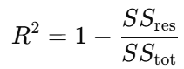
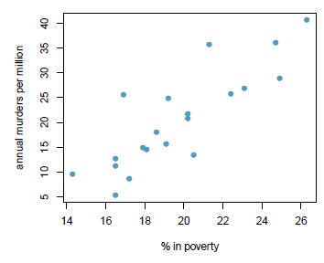
Coefficient of Determination (R Squared)
Represents the proportion of the variance in the dependent variable that is explained by the independent variables in the model and gives a measure of the model’s predictive power:
Coefficient of Determination is the square of Coefficient of Correlation (r) if there is only one independent variable.
Values range from 0 to 1. 0 means the model explains none of the variance. 1 means the model explains all of the variance.
A big value of R-Squared indicates the dependent variable can be explained well by the independent variable(s) with a linear model, and it is commonly used (though not the only one) as a performance metric of the regression model.
R-Squared is 0.71 it means that 71% of the variability in the murder rates is explained by the model
R-Squared near one shows significant predictive power of independent variables

Slide 11
Simple Linear Regression
Simple refers to the fact that there is a single independent variable in a linear relationship with the dependent variable
“Regress X on Y” will mean to finding the equation for the straight-line fits best to training data on modeling Y based on X
ŷ is the respective estimate of the y-value. This means that for each x-value the corresponding y-value is estimated.

Slide 12
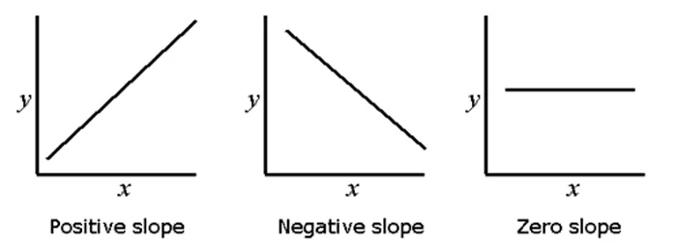
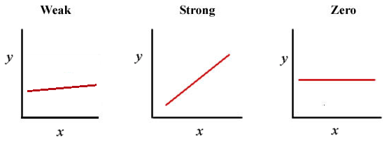
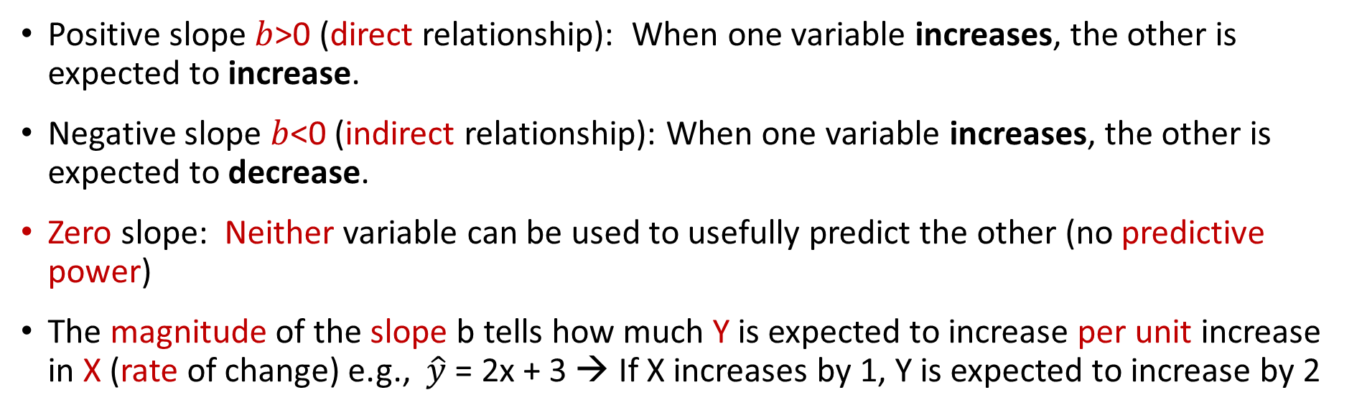
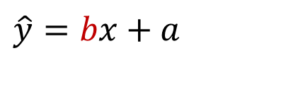
Interpreting the Slope (Reg Coefficient)
$$\hat{y}=bx+a$$
Positive slope $b$>0 (direct relationship): When one variable increases, the other is expected to increase.
Negative slope $b$<0 (indirect relationship): When one variable increases, the other is expected to decrease.
Zero slope: Neither variable can be used to usefully predict the other (no predictive power)
The magnitude of the slope b tells how much Y is expected to increase per unit increase in X (rate of change) e.g., $\hat{y}$ = 2x + 3 → If X increases by 1, Y is expected to increase by 2

Slide 13
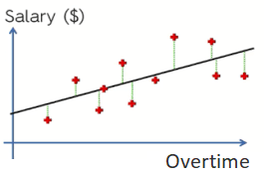
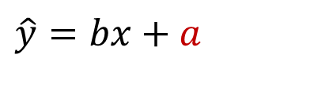
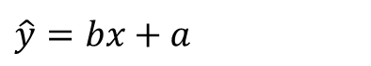
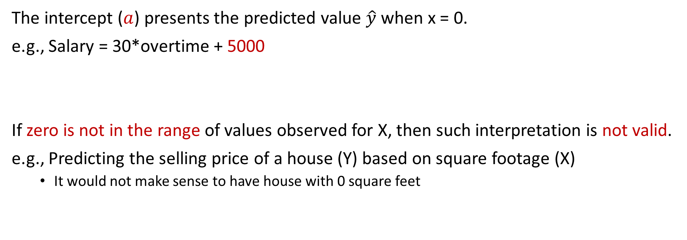
Interpreting the Intercept
$$\hat{y}=bx+a$$
The intercept ($a$) presents the predicted value $\hat{y}$ when x = 0.
e.g., Salary = 30*overtime + 5000
If zero is not in the range of values observed for X, then such interpretation is not valid.
e.g., Predicting the selling price of a house (Y) based on square footage (X)
It would not make sense to have house with 0 square feet
$$\hat{y}=bx+a$$
PRICE = 83*SQRFT + 12,510
Notes:
13

Slide 14
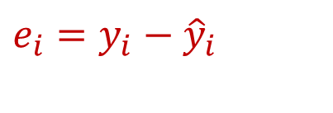
Residual
A residual (prediction error) is the difference between the observed value (𝒚) and the predicted value (𝒚 ̂) for each observation:
$$e_{i}=y_{i}−{\hat{y}}_{i}$$

Slide 15
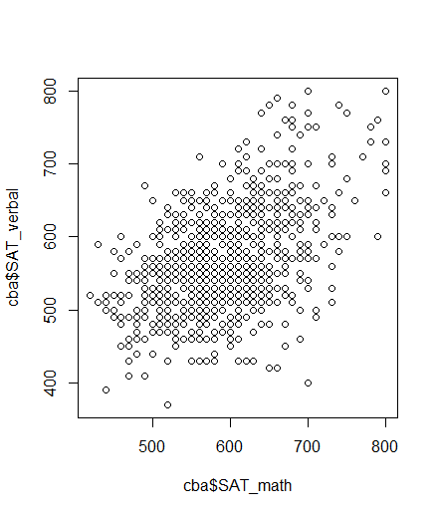
Problem Statement : Training Objective
Problem: There are many possible straight lines fit the training data, but which of these lines fits best?
A small residual means that the actual value is close to the predicted value by the regression line which is desirable.
The target (training objective) is to find a line fits to training data best, so we need to find the least total residuals.
We need a measure to quantify the total residuals for optimization

Slide 16
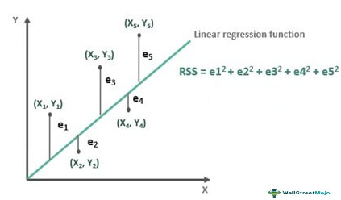
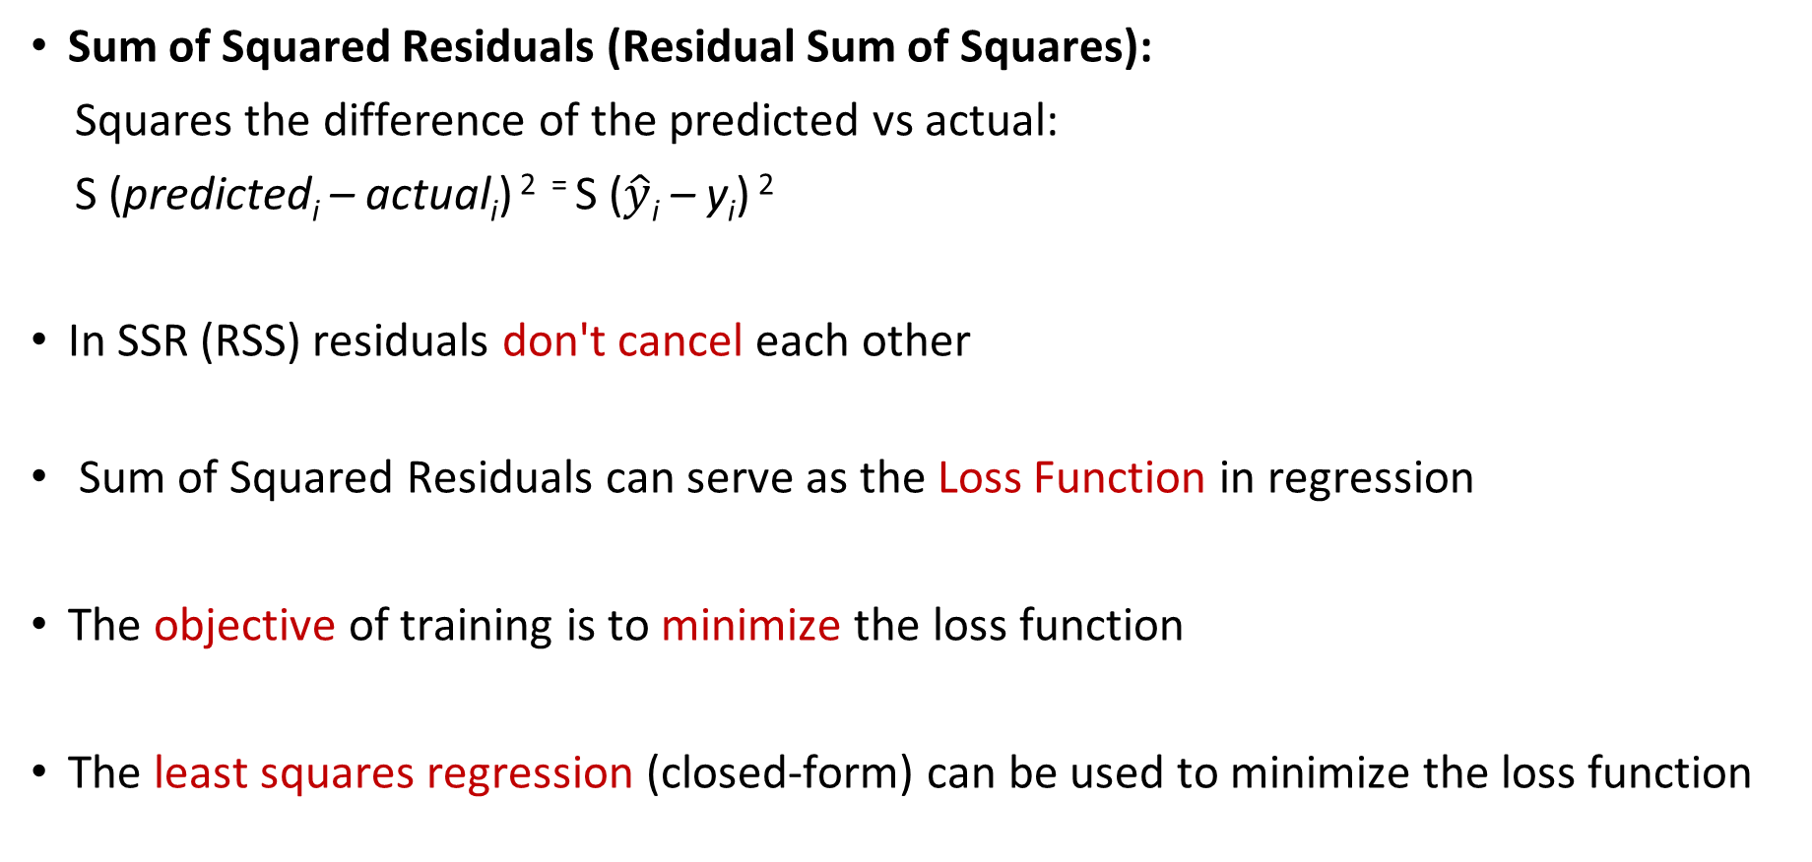
Sum of Squared Residuals as Loss Function
Sum of Squared Residuals (Residual Sum of Squares):
Squares the difference of the predicted vs actual:
S (predicted_{i} – actual_{i}) ² ⁼ S ($\hat{y}$_{i} – y_{i}) ²
In SSR (RSS) residuals don't cancel each other
Sum of Squared Residuals can serve as the Loss Function in regression
The objective of training is to minimize the loss function
The least squares regression (closed-form) can be used to minimize the loss function
Notes:
Would choose middle 9+9 < 49

Slide 17
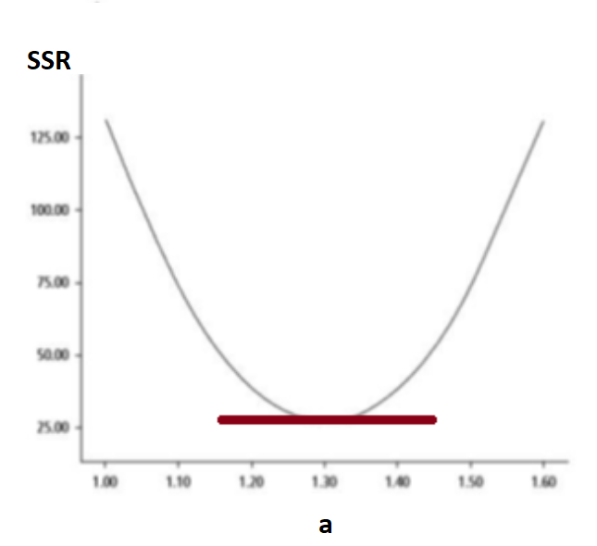

Closed-form Method
ŷ = a + bx
SSR = Σ(y — ŷ)² = Σ(y — a — bx)²
To minimize SSR, we take the partial derivatives of SSR with respect to m and b, set them equal to zero, and solve for a and b.

Slide 18
Partial Derivative
SSR = Σ(y — a — bx)²
Taking the partial derivative of SSR with respect to b:
∂SSR/∂b = -2Σx(y — a — bx) = 0
Σxy — aΣx — bΣx² = 0
b = (Σxy — aΣx) / Σx²
Taking the partial derivative of SSR with respect to a:
∂SSR/∂a = -2Σ(y — a — bx) = 0
Σy — na — bΣx = 0
a = (Σy — bΣx) / n = 𝑦 ̄−𝑏𝑥 ̄

Slide 19
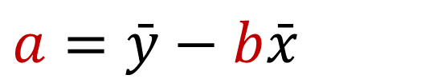
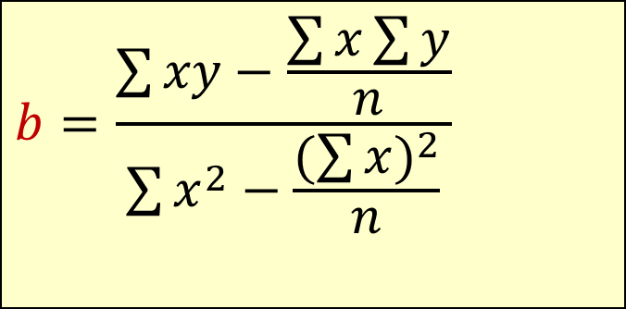

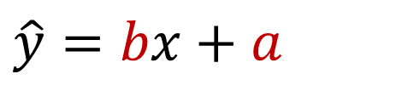
The Least Squares Equation
To minimize loss, values of a and b should be :
1) b = (Σxy — aΣx) / Σx²
2) a = (Σy — bΣx) / n
$$b=\frac{\sum{xy−\frac{\sum{x\sum{y}}}{n}}}{\sum{x^{2}−\frac{(\sum{x})^{2}}{n}}}$$
After calculation of b:
1,2 →
$$a=\bar{y}−b\bar{x}$$
2 →
After calculation of a and b:
$$b=\frac{\sum{\left(x −\bar{x}\right)(y−\bar{y})}}{\sum{{\left(x −\bar{x}\right)}^{2}}}$$
$$\hat{y}=bx+a$$

Slide 20
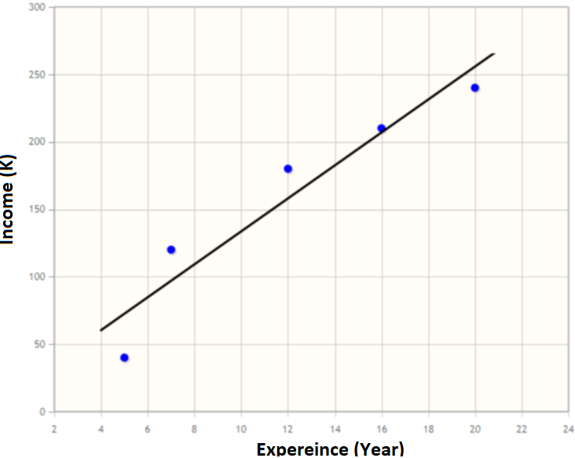
Regression Line Calculation - Example
Suppose that we want to train a simple regression model to predict income of employees based on their work experience
Values of a and b can be calculated using the formula in a way that minimize loss on the training data:
Training Data
Experience (Year) | Income (K)
5 | 40
7 | 120
12 | 180
16 | 210
20 | 240

Slide 21

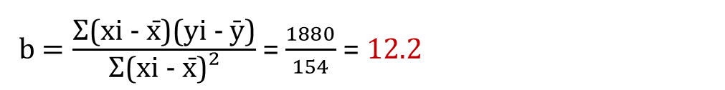
Closed Form Calculation - Example
xi | yi | xi - x̄ | yi - ȳ | (xi - x̄)(yi - ȳ) | (xi - x̄)²
5 | 40 | 5 - 12 = -7 | 40 - 158 = -118 | -7 × -118 = 826 | (-7)² = 49
7 | 120 | 7 - 12 = -5 | 120 - 158 = -38 | -5 × -38 = 190 | (-5)² = 25
12 | 180 | 12 - 12 = 0 | 180 - 158 = 22 | 0 × 22 = 0 | 0² = 0
16 | 210 | 16 - 12 = 4 | 210 - 158 = 52 | 4 × 52 = 208 | 4² = 16
20 | 240 | 20 - 12 = 8 | 240 - 158 = 82 | 8 × 82 = 656 | 8² = 64
Σx = 60 | Σy = 790 |  |  | Σ(xi - x̄)(yi - ȳ) = 1880 | Σ(xi - x̄)² = 154
x̄ = 60/5=12 | ȳ=790/5=158
b $=\frac{\text{Σ}\text{(}\text{xi} \text{− }\text{x}\text{̄}\text{)(}\text{yi} \text{− }\text{ȳ}\text{)}}{\text{Σ}\text{(}\text{xi} \text{− }\text{x}\text{̄}\text{)}\text{²}}$= $\frac{1880}{154}$= 12.2
$$\hat{y}=bx+a$$
$$a=\bar{y}−b\bar{x}=158 −(12.2∗12)=11.5$$
$$Income=(12.2∗Experience)+11.5$$

Slide 22
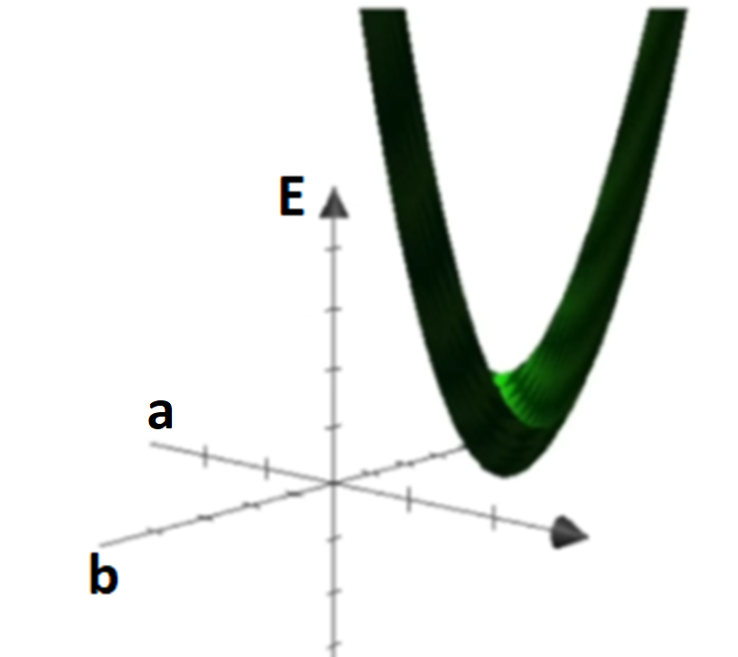
Gradient Descent Approach
The closed form is computationally expensive (especially for large datasets with many features)
For many computationally expensive problems, greedy approaches can provide reasonable solutions at much lower computational cost
A greedy approach solves a problem step by step by making the best (locally optimal) decision at each step (not necessarily global optimal decision)
One common greedy approach is gradient descendent.
Gradient descendent tries to moves in the direction of the steepest decrease of the loss

Slide 23
Gradient Descent - Intuitive
Gradient is the vector of partial derivatives with respect to each parameter:
Zero slope of gradient → it is Minimum point (sometimes local minimum)
Big slope of gradient It→ is far from zero slope (which we are looking for) → we need bigger decrease
Small slope of gradient → It is near to zero slope (which we are looking for) → we need smaller decrease (not passing by)
1,2,3 → A greedy idea:
In each step, subtract a value proportional to last gradient (bigger value for big gradient and smaller value for small gradient) to get closer to minimum point.

Slide 24
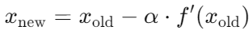
Learning Process
It starts with random initial numbers for parameters and iteratively updating the model’s parameters in the negative gradient direction.
In each iteration of the algorithm, the gradient of the cost function with respect to each parameter is computed.
The size of the step is controlled by the learning rate, which determines how quickly the algorithm moves towards the minimum.
The process is repeated until the gradient (slope) becomes close to zero or after a predefined number of steps

Slide 25

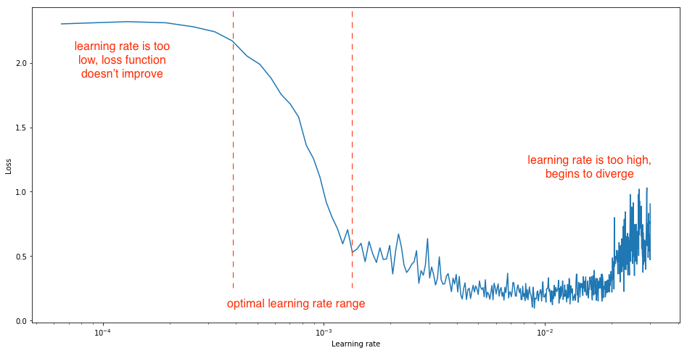
Learning Rate
Learning rate is a hyperparameter that determines how big a step is taken.
A too high learning rate will make the learning jump over minima
A too low learning rate will either take too long to converge or get stuck in a local minimum
Optimal learning rate depends on the model and can be determined using the validation data

Slide 26
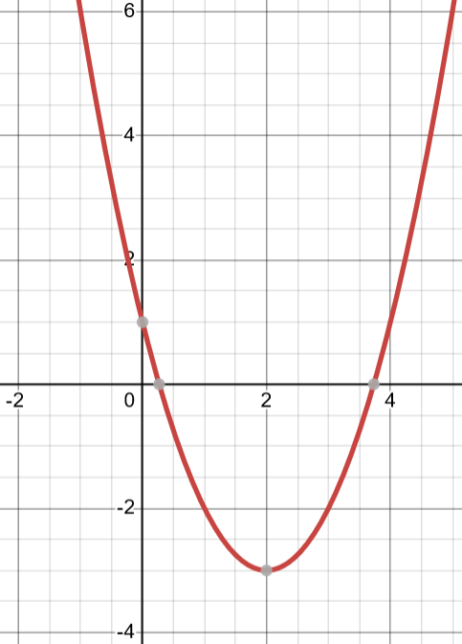
Gradient Descent – Example1
Suppose that we want to find the parameter x in a way that minimize f(x) which can be the loss:
1- Calculate the derivative
The derivative (or gradient) of the function is: f′(x)=2x−4
2- Choose a starting point
Start at x0=9. (This is an initial guess for the minimum)
3- Choose a learning rate
learning rate α=0.1
$$\text{f}\text{(}\text{x}\text{)}={\text{x}}^{2}−4x+1$$
x

Slide 27
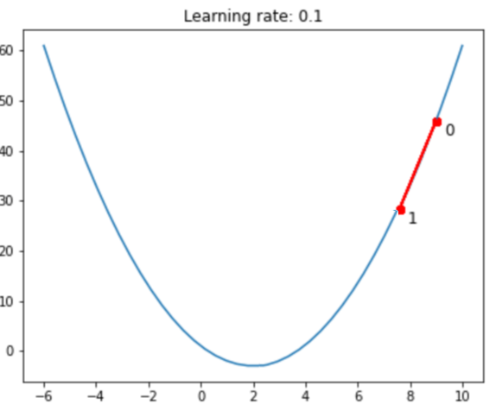
Gradient Descent – Example1
4- Perform the gradient descent step
To update value of x, the formula is used:
Iteration 1:
Starting point: x0=9
f′(x)=2x−4 → Gradient at x0: f′(9)=2×9−4=14
Update x: x1= x0 – α*f′(x0) = 9 − 0.1×(14)=7.6

Slide 28
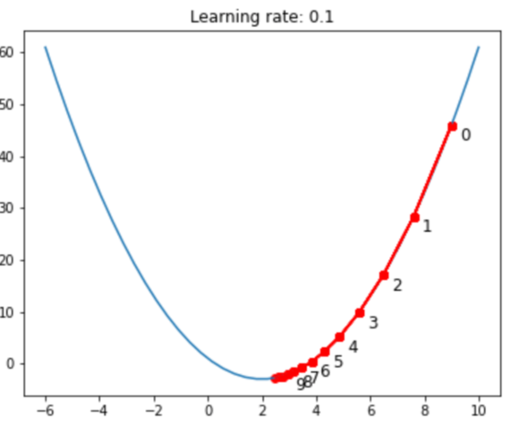
Gradient Descent – Example1
Iteration 2:
x1=7.6
f′(x)=2x−4 → f′(x1)=2(7.6)−4=15.2−4=11.2
Update x: x2= x1 – α*f′(x1) =7.6−0.1×11.2=7.6−1.12=6.48
Iteration 3:
x2=6.48
f′(x)=2x−4 → f′(x2)=2(6.48)−4=12.96−4=8.96
Update x: x3 = x2 – α*f′(x2) =6.48−0.1×8.96=6.48−0.896=5.584
Iteration 4:
x3=5.584
f′(x)=2x−4 → f′(x3)=2(5.584)−4=11.168−4=7.168
Update x: x4 = x3 – α*f′(x3) =5.584−0.1×7.168=5.584−0.7168=4.8672
Iteration 5:
x4=4.8672
f′(x)=2x−4 → f′(x4)=2(4.8672)−4=9.7344−4=5.7344
Update x: x5 = x4 – α*f′(x4) =4.8672−0.1×5.7344=4.8672−0.57344=4.29376
…
5- Process continues till gradient gets close to zero or maximum number of iterations

Slide 29
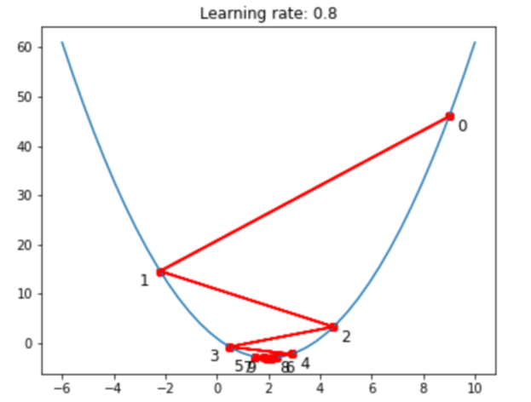
Gradient Descent – Example2
by taking a learning rate of 0.8 and starting point at x=9
Iteration 1:
Starting point: x0=9
f′(x)=2x−4 → Gradient at x0: f′(9)=2×9−4=14
Update: x1= x0 – a*f′(x0) = 9 − 0.8×(14)=-2.2
Iteration 2:
x1= -2.2
f′(x)=2x−4 → Gradient at x1: f′(-2.2)=2×-2.2−4= -8.4
Update: x2= x1 – a*f′(x1) = -2.2 − 0.8×(-8.4)= 4.52
Iteration 3:
…

Slide 30
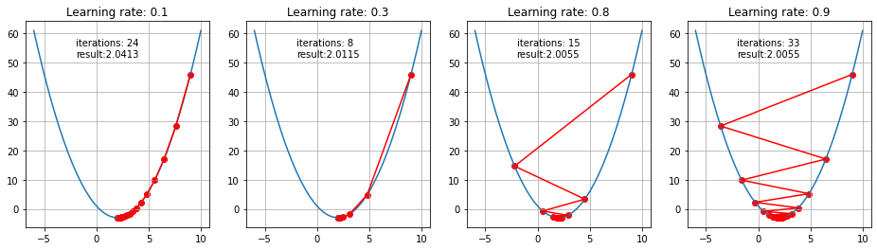
Effect of Learning Rate
Steps taken by GD for small and big learning rates:

Slide 31
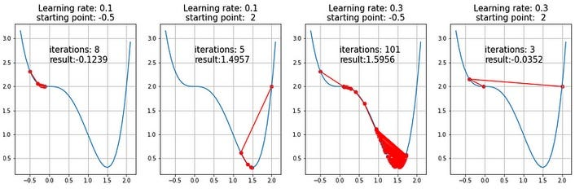
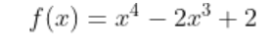
Saddle Points
Saddle Points: Points where the gradient is near to zero but are not a minimum. Gradient descent can get stuck at these points (local optimal), leading to slow convergence or failure to find the global optimal solution.
Investigation of saddle points and how to escape from saddle points is a subject of ongoing studies and various solutions were proposed

Slide 32
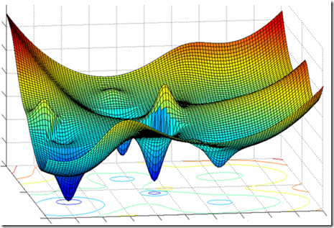
Multiple Linear Regression (Multi-Variable)
Explains a dependent variable using more than one independent variable
It evaluates the relative effect of independent variables on the dependent variable when holding all the other variables in the model constant.
Both closed-form and gradient descent (for large/high-dimensional datasets) can be used for training multiple linear regression

Slide 33
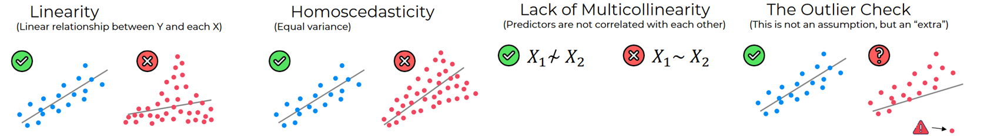
Conditions for regression
Some Assumptions of Linear Regression
The training data is representative of the target population (general condition)
Linear association between dependent and independent variables
Residuals are expected to be random (no bias)
Independent variables are not highly correlated linearly (no multicollinearity)
Constant variability of residuals (no homoscedasticity)

Slide 34
Bias vs Error
In linear regression, the prediction errors (residuals) are expected to be random to satisfy the assumptions of the model
Bias is a systematic error that occurs due to inability of the model to fit training data.
In a model with a low bias, average of error is near zero
In a model with a high bias, average of error is not zero and model is biased to higher or lower values

Slide 35
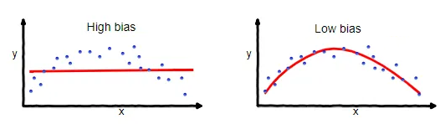
Addressing Bias
Add Omitted Variables: The model is missing important independent variables that affect the dependent variable.
Underfitted Model: The model might not have been trained properly, so it should be trained with proper settings/ hyperparameters .
Incorrect Model: The true relationship between variables is not linear, therefore, a non-linear model should be used.

Slide 36
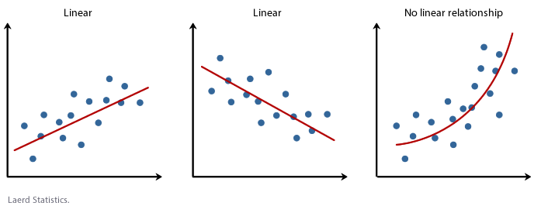
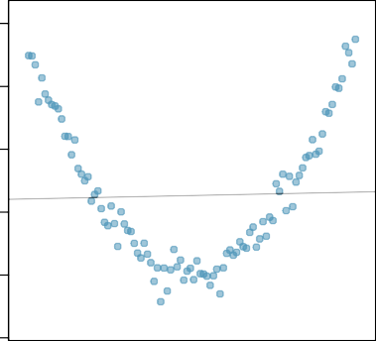
Conditions for regression
Linearity
Linear regression is only applicable when there is linear association between dependent and independent variables:
Linear associations can be recognized using correlation coefficient (r)
Type of association can be also recognized using scatter plots
Estimating non-linear relationships with linear regression leads to a biased model
Scatter Plot
1000 1500 2000
y
500
← Non-linear association →
0
x

Slide 37

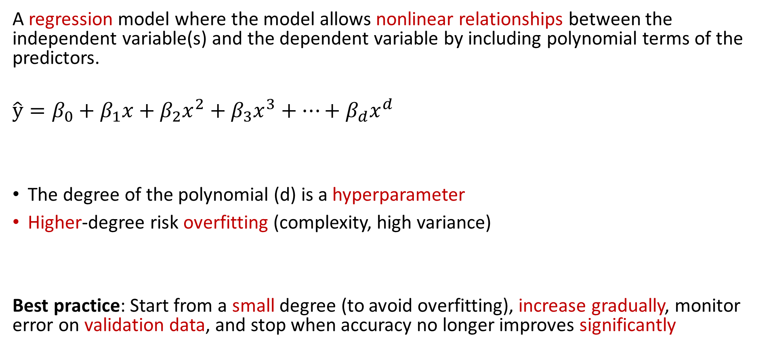
Polynomial Regression
A regression model where the model allows nonlinear relationships between the independent variable(s) and the dependent variable by including polynomial terms of the predictors.
$$\hat{y}=β_{0}+β_{1}x+β_{2}x^{2}+β_{3}x^{3}+⋯+β_{d}x^{d}$$
The degree of the polynomial (d) is a hyperparameter
Higher-degree risk overfitting (complexity, high variance)
Best practice: Start from a small degree (to avoid overfitting), increase gradually, monitor error on validation data, and stop when accuracy no longer improves significantly
Closed-form solutions can be used for polynomial regression.

Slide 38
Multicollinearity
In multicollinearity two or more independent variables are highly correlated linearly with each other which causes problems for a regression model:
Unstable Coefficient Estimates: The estimated coefficients may become highly sensitive to small changes in the training data (high variance)
Difficulty in Interpretation: When predictors are highly correlated, it becomes challenging to interpret the effect of each predictor on the dependent variable since their effects are intertwined.
If x1​ and x2​ move together (high correlation), it is not clear whether y is changing because of x1 or x2. This makes training unstable (The model can’t separate their contributions) and many different combinations of 𝛽1​ and 𝛽2​ explain the data equally well

Slide 39
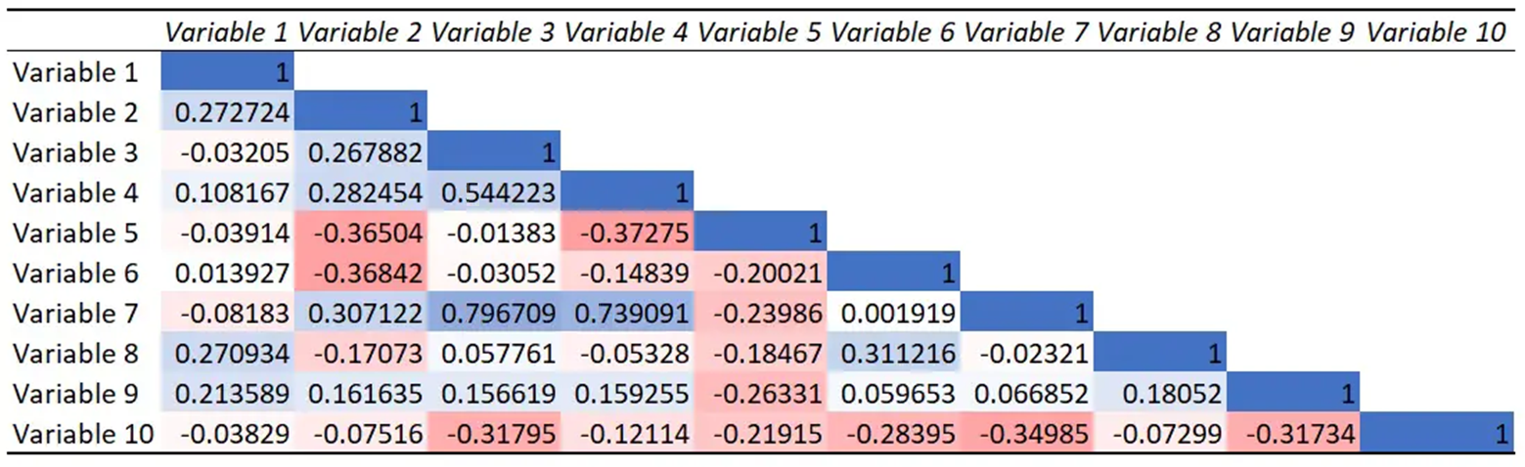
Addressing Multicollinearity – Feature Eng
Compute the correlation matrix of independent variables to detect high correlations (e.g., above 0.7)
Remove or combine highly correlated predictors:
Remove one of each pair of highly correlated variables
Use feature reduction techniques (e.g., PCA) to transforms the independent variables into a set of uncorrelated variables
3. Sometimes in small dataset features may randomly appear correlated, increasing the size of training data can help to decrease the impact of such multicollinearity.

Slide 40
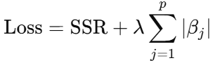
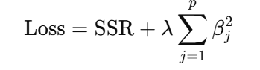
Addressing Multicollinearity - Regularization
One cause of multicollinearity is a large number of independent variables
Regularization can reduce multicollinearity (also overfitting) by adding a penalty term to the loss function based on the size of the coefficients.
This penalty shrinks less important coefficients toward zero (make them less effective)
1- Lasso Regression (L1 regularization): Adds a penalty proportional to the sum of absolute values of coefficients (Can shrink some coefficients exactly to zero)
2- Ridge Regression (L2 regularization): Adds a penalty proportional to the sum of squared coefficients (Shrinks coefficients toward zero, but not exactly zero, more common to address multicollinearity)
λ controls how strong the penalty is on coefficients

Slide 41
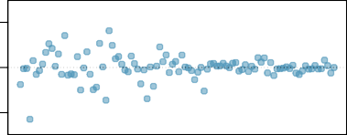
Heteroscedasticity
Variance of the residuals is not constant across all levels of the independent variables because:
Outliers or extreme values in dependent variable can disproportionately influence the variance of residuals
Important predictor variables are left out of the model
The relationship between the independent and dependent variables may not be linear
The variability of the dependent variable increases with its level. For example, House price differences might vary only a little for small houses but for large houses based on their facilities (e.g., luxury features) it can be large, leading to heteroscedastic residuals.
Etc.
−2000 0 2000
Residuals
Residuals (prediction error) range changes as x gets large
x

Slide 42


Addressing Heteroscedasticity
Using data preprocessing to remove outliers and noises
Adding omitted variables or modify variables
Using non-linear model if the relationships between dependent and independent variables is not linear
Apply transformations that stabilize variance of dependent variables
E.g., log transformation

Slide 43

Regression for Classification
Regression models can be adapted for classification tasks
Linear regression can be trained to separate two classes (class 0 under the line and class 1 over the line) if classes are linearly separable
Values on one side of the regression line (negative outputs) are assigned to class 0, and values on the other side (positive outputs) to class 1.
Problem : There is no difference between a very high positive value (a good signal of a class 1) and a very small positive value (the same problem also for the negative values)

Slide 44


Logistic Regression
Applies the Sigmoid function to the linear regression output, converting it into a probability of a class (a value between 0 and 1)
Simple Logistic Regression
y = Sigmoid (bX + a)
Multivariable logistic regression
y = Sigmoid (β₀ + β₁x₁ + β₂x₂+… β_{n}x_{n})

Slide 45


Binary Classification with Probabilities
LR outputs a value between 0 and 1. Larger positive values produce outputs closer to 1 and larger negative values produce outputs closer to 0.
The output of the logistic function is interpreted as the probability that a given input x belongs to the positive class.
For two classes, if the value is greater than a threshold (e.g., 0.5) then it belongs to Class 1, otherwise it belongs to Class 0.

Slide 46
Logistic Regression - Example
Task: Predicting Sepsis (label) using the following features:
Feature 1 (x1): Severity of Fever (0-3)
Feature 2 (x2): Severity of Chills (0-3)
Suppose after training model using the training data, the coefficients would be as follows: B0= -1.0, B1= 0.5 , B2= 0.8
Training Data
Fever Severity | Chills Severity | Sepsis
3 | 1 | 1
0 | 0 | 0
1 | 2 | 1
0 | 1 | 0
2 | 3 | 1
y = Sigmoid (β₀ + β₁x₁ + β₂x₂+… β_{n}x_{n})
y = Sigmoid (− 1.0 + 0.5×Fever + 0.8×Chills)

Slide 47
Logistic Regression – Inference Example
Probability(Sepsis ∣ Fever Severity, Chills Severity)= Sigmoid (0.5× Fever + 0.8× Chills − 1.0)
To classify new cases, we can use the trained model:
Probability(Sepsis∣2,1)= Sigmoid(0.5×2+0.8×1−1.0) = Sigmoid (1.6) ​= 0.832
Since 0.832 is greater than 0.5, the model classifies the case as Sepsis.
Probability(Sepsis∣1,0)= Sigmoid(0.5×1+0.8×0−1.0) = Sigmoid (-0.5) ​= 0.377
Since 0.377 is less than 0.5, the model classifies the case as Normal.
New Data
Fever Severity | Chills Severity | Sepsis
2 | 1 | ?
1 | 0 | ?
Questions: Is threshold of 0.5 the best threshold?
Which threshold detect most positive cases?
Which thresholds gives less false positive cases?

Slide 48


Tuning Threshold using ROC
By calculating TP rate and FP rate for each threshold value of LR (or other models), the resulting curve (Receiver Operating Characteristic), shows how well each threshold can distinguish between positive and negative classes.
The Area Under the Curve (AUC) quantifies the performance of the classifier across all possible thresholds. This makes AUC a more general measure of classifier performance (rather than individual thresholds). AUC is less sensitive to class imbalance than accuracy since it considers both TP rate and FP rate.
Choosing a threshold around the ankle often gives a good trade-off: decent true positive rate without too many false positives.
A perfect classifier would have an AUC of 1.0, while a random classifier would have an AUC of 0.5 for binary classification
True Positive Rate = TP / TP + FN
False Positive Rate = FP / FP + TN

Slide 49



Data Pre-processing for Regression
Categorical variables: need to be converted into a series of variables which can then be entered into the regression model (e.g., one-hot encoding).
Missing Values: need to be imputed to be entered into the regression model
Normalizing : recommended for multiple independent variable where predictors may be on different scales, makes coefficients comparable
Filter out outliers: recommended for regression which is prone to outliers
$$\hat{y}=bx+a$$
$$b=\frac{\sum{\left(x −\bar{x}\right)(y−\bar{y})}}{\sum{{\left(x −\bar{x}\right)}^{2}}}$$

Slide 50

Applications of Regression - Trend Analysis
Trend analysis is analyzing the dependent var over time (time as independent var) to identify consistent patterns or movements (upward, downward, or stable):
Time-based regression is one of the main tools for trend analysis in time-series data, because it can mathematically model how a variable evolves over time
Dependent variable is regressed against time (independent variable)
In time-based regression, the coefficients represent the rate of trend (change in the dependent variable for one unit increase in time)

Slide 51


Applications of Regression – Data Generation
Regression can be used to generate realistic artificial data (synthetic) when privacy concerns prevent sharing real data or more training data is needed
Regression is widely used for filling in missing values (e.g., in MICE)
science = 1.3 * math + 10.63

Slide 52

K Nearest Neighbor (KNN)
KNN is a supervised learning technique
Classify a new data point like similar training example(s)
Similar means similar feature values (nearest feature values)
← Plus(+) or Minus(-) Class?
Idea: Similar features indicates similar class

Slide 53

Nearest Neighbors
More similarity means less distance between features
K-nearest neighbors of x are data points that have the k smallest distance to x
Class of x is assigned based on majority of k nearest neighbors
Problem: needs a measure for distance

Slide 54
Distance Measures
Euclidean Distance:
Manhattan Distance:
Chebyshev Distance:
$$d(x,y)=\sqrt{(x−y)^{2}}=\sqrt{\sum_{i=1}^{d}{(x_{i}−y_{i})^{2}}}$$
$$d(x,y)=|x−y| =\sum_{i=1}^{d}{|x_{i}−y_{i}|}$$
$$d(x,y)=max_{1≤i≤d}|x_{i}−y_{i}|$$
1 2 3 4 5
Feature 2
X (1,5)
$$Euclidean=\sqrt{\sum_{i=1}^{d}{(x_{i}−y_{i})^{2}}}= ({(1−3)}^{2}+{(5−1)}^{2})^{\frac{1}{2}}=4.47$$
$$Manhattan=\sum_{i=1}^{d}{|x_{i}−y_{i}|}=|\left(1−3\right)|+|(5−1)|=6$$
$$Chebyshev=Max(\left|\left(1−3\right)\right|,|(5−1)|)=4$$
$$4$$
Y (3,1)
$$2$$
Feature 1
1 2 3 4

Slide 55

KNN Steps
KNN doesn’t explicitly build a model during training, during inference it classify new data by comparing them with training data (lazy classifier):
Get a test data point
Calculate distance between data points with training data points
Find k nearest neighbors (less distance)
Assign a label / value based on nearest neighbors (majority vote / average)

Slide 56
KNN Example
Features: height(cm) and weight (kg)
Labels: Normal / Underweight
Weight | Height | Class (Label)
51 | 167 | Underweight
62 | 182 | Normal
69 | 176 | Normal
64 | 173 | Normal
65 | 172 | Normal
56 | 174 | Underweight
58 | 169 | Normal
57 | 173 | Underweight
55 | 170 | Normal
KNN Algorithm:
Classify new data based on similarity with training data
Datapoint with Unknown Class
57 kg | 170 cm | ?

Slide 57
KNN Example – Calculate Distance
Euclidean Distance = $\sqrt{(Weight1−Weight2)^{2}+(Hight1−Hight2)^{2}}$
Weight | Height | Class | Euclidean Distance
51 | 167 | Underweight | 6.7
62 | 182 | Normal | 13
69 | 176 | Normal | 13.4
64 | 173 | Normal | 7.6
65 | 172 | Normal | 8.2
56 | 174 | Underweight | 4.1
58 | 169 | Normal | 1.4
57 | 173 | Underweight | 3
55 | 170 | Normal | 2
$$\sqrt{(51−57)^{2}+(167−170)^{2}}$$
$$\sqrt{(62−57)^{2}+(182−170)^{2}}$$
$$…$$
57 kg | 170 cm | ?
Unknown data point

Slide 58
Classifying Based on Training Data
Class of x is assigned based on majority of k nearest neighbors
K is a hyperparameter of KNN that needs to be tuned
Weight | Height | Class | Euclidean Distance
51 | 167 | Underweight | 6.7
62 | 182 | Normal | 13
69 | 176 | Normal | 13.4
64 | 173 | Normal | 7.6
65 | 172 | Normal | 8.2
56 | 174 | Underweight | 4.1
58 | 169 | Normal | 1.4
57 | 173 | Underweight | 3
55 | 170 | Normal | 2
K=3
Normal
57 kg | 170 cm

Slide 59

Number of Neighbors (K)
If k is too small, sensitive to noise points in training data (overfitted)
If k is too large, neighborhood may include points from other classes (underfitted)
K (hyper-parameter) needs to be tuned in a way that avoid overfitting and underfitting (right fit)
Rule of thumb:
K <= sqrt(N)
N: number of training points

Slide 60

Optimal K
We can use validation data to find optimal K
Choose an odd “K” value for a Binary Classification problem.
“K” must not be a multiple of the number of classes for a Multi-class Classification problem

Slide 61

KNN Advantages
Simple and interpretable
Provides reasonable results on small datasets with limited features
KNN is a lazy classifier and requires no training time but needs more time for inference
Requires little tuning of hyper-parameters.
Learn non-linear decision boundaries when used for classification.

Slide 62

KNN Disadvantages
Computationally Expensive for Large Datasets: To determine the nearest neighbour of a data point, must compute the distance to all training data.
Pre-sort training data points into fast data structures (e.g., tree)
Cluster data points and just use centroids as training set
Compute only an approximate distance
Condensing
Curse of Dimensionality : Required amount of training data increases exponentially with dimension. Prediction accuracy can quickly degrade when number of attributes grows
Remove irrelevant attributes
More training data

Slide 63

Distance Approximation
Early Stopping in Distance Calculation
If using Euclidean distance, computation can be stopped early if the squared distance exceeds the threshold.
Using Manhattan distance as a quick filter before computing exact Euclidean distance.
Dimensionality Reduction
Use PCA to reduce the feature space before computing distances.
Approximate nearest neighbors are found in a lower-dimensional space.
3.Hashing Techniques
Mapping new data points using a hash function in a way that similar points are likely to fall into the same or nearby buckets. Nearest neighbors are searched only within those nearby buckets.

Slide 64

Condensation: Decision Regions
Retain only a subset of the training samples that define the classification regions effectively
Reduce the training dataset while preserving the decision boundaries
Reducing storage and improving query efficiency.
By selecting representative samples, outliers and redundant points are removed.

Slide 65

Data Pre-processing for KNN
Missing Values are required to be imputed since distance metrics are employed.
Normalizing data is recommended since distance-based classifiers are sensitive to scaling and different features may have different measurement scales
Filter out outliers is recommended for KNN algorithm since KNNs with smaller number of K are prone to noise and outliers
$$Euclidean Distance=\sqrt{\sum_{i=1}^{d}{(x_{i}−y_{i})^{2}}}$$

Slide 66

Applications of KNN
Many applications including:
Regression (average of K nearest)
Generating synthetic data (SMOTE)
Outlier detection (high average distance)
Information retrieval (nearest to query)
Imputing missing values:
Daily Dose of Data Science

Slide 67

Assignment 4
Train a multiple linear regression on hw4_train.csv dataset with ‘BloodPressure’ as the dependent variable (target) and all other features (but not “Outcome”) as independent variables (inputs).
Using the regression model, predict and set values of ‘BloodPressure’ in hw4_test.csv dataset.
Train 19 KNN models with k from 1 to 19 on hw4_train.csv dataset with “Outcome” as label and all other attributes as features.
Calculate accuracy of the model for test data (containing predicted values of ‘BloodPressure’).
Report the K with the highest accuracy

